Slide 1

FEEL LIKE HOME
A Home Rental Company’s Data analysis
FEEL LIKE HOME
Data Analysis for FLH

Slide 2
CONTENTS
Introduction
Objectives
Data Lifecycle
Importing and Reading Data
Handling Missing Values
Data Analysis, Insights and Results

Slide 3
Objectives
Target High-Demand Neighborhoods
Optimize Pricing Strategies
Identify Successful Property Types
Understand Customer Preferences
Enhance Host Attributes
Boost Traction for Unpopular Properties

Slide 4
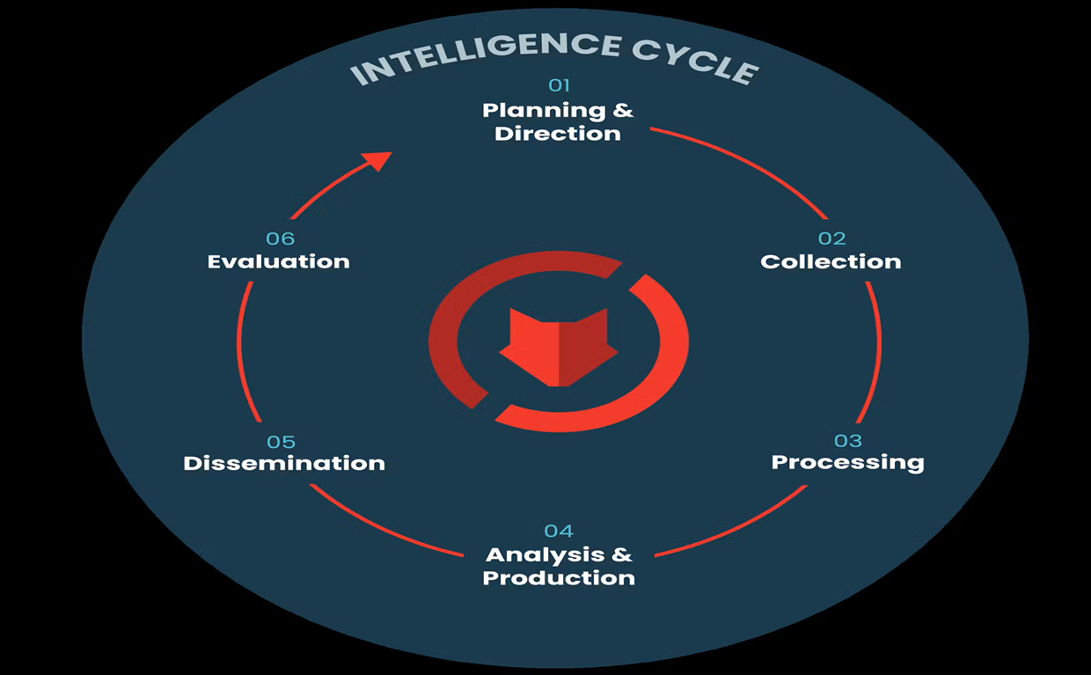
Data LIFE CYCLE

Slide 5
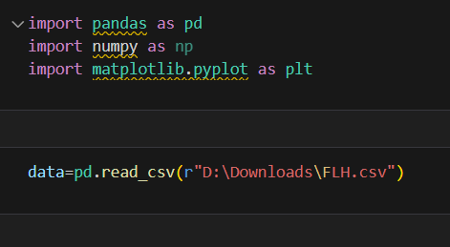
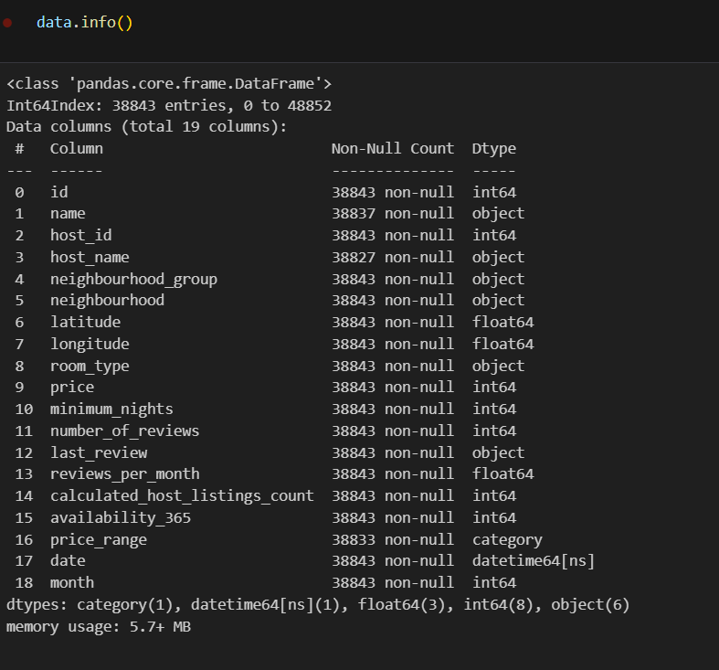
Exploratory data analysis

Slide 6
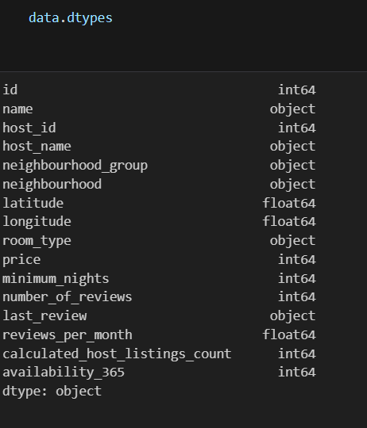
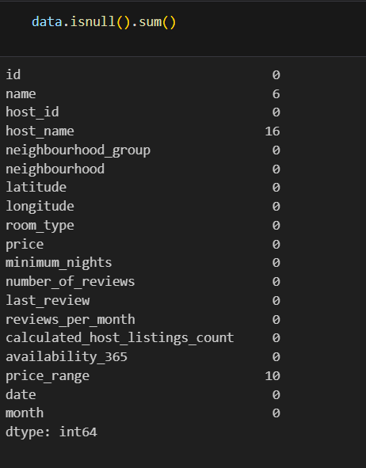
Exploratory Data Analysis
We can observe that the dataset
Contains some null values and are
Handled according to the business
Needs.

Slide 7
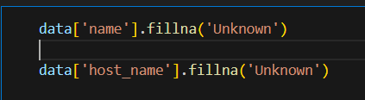
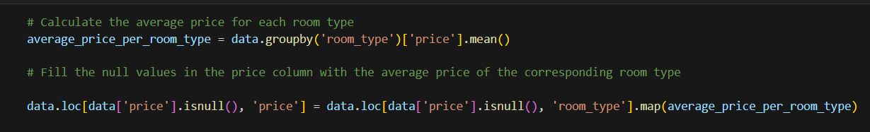
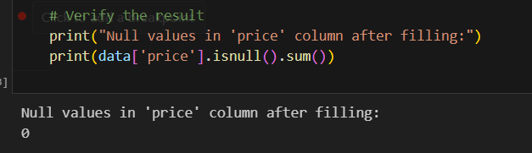
Exploratory Data Analysis
We have handled null values of ‘Name’,’ Host Name’,and price

Slide 8
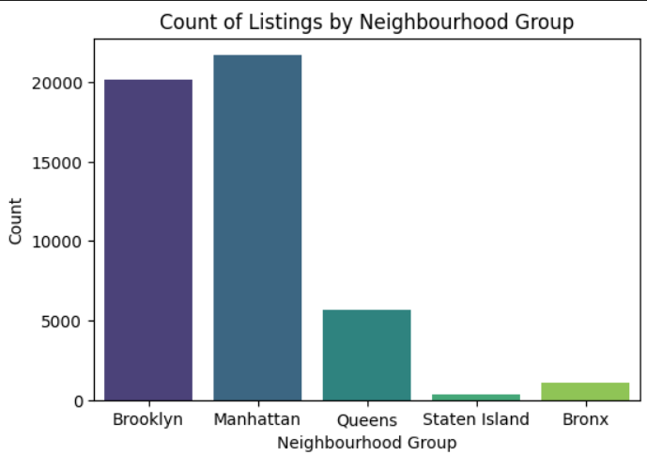
Exploratory Data Analysis
Q1. What are the Neighborhoods that FLH Needs to Target?
Target neighborhoods for FLH
High-priority Neighbourhood: Based on the data FLH should target the “Neighborhood” with the highest listing counts
85 % of the listings are Manhattan and Brooklyn neighbourhood_group.

Slide 9
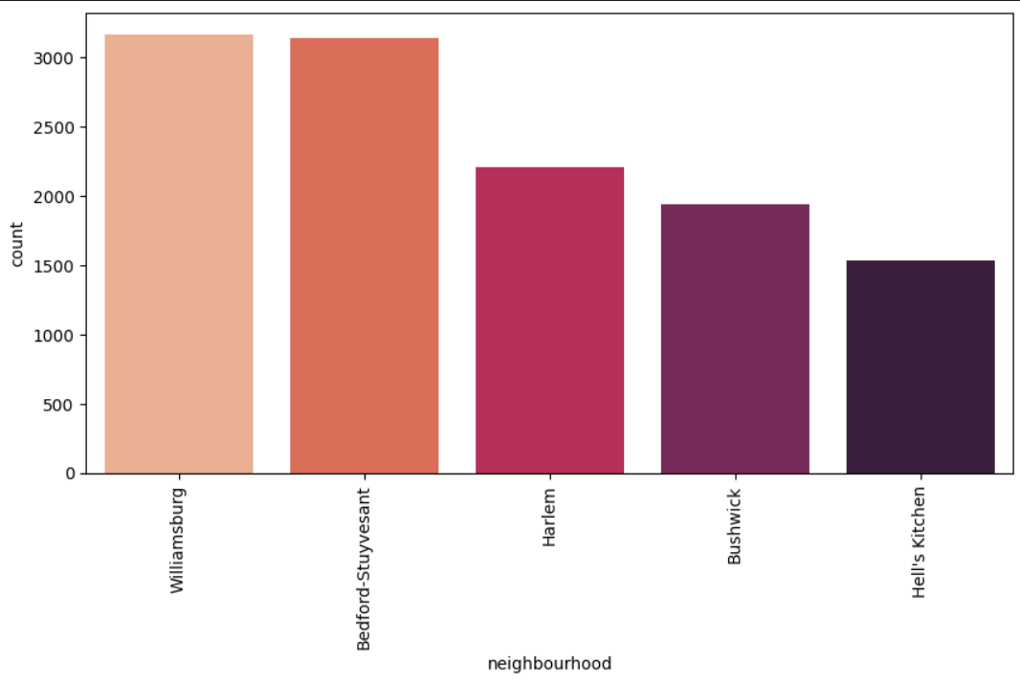
Exploratory Data Analysis
Brooklyn: Williamsburg (3920), Bedford-Stuyvesant (3714), Bushwick (2465)
Manhattan: Harlem (2658), Upper West Side (1971)
These areas have demonstrated high customer demand and should be targeted for marketing and property acquisition efforts

Slide 10
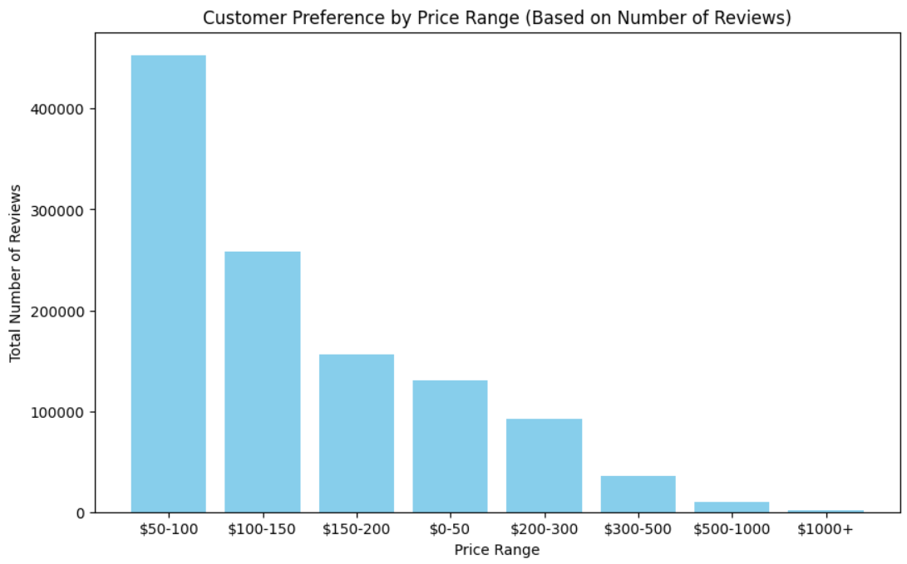
Exploratory Data Analysis
Q2. What are the price ranges preferred by FLH Customers?
Interpretation:
Most Popular Price Range: The range with the highest number of reviews is likely the most preferred by customers.
Low-Preference Ranges: Ranges with fewer reviews might be less attractive to customers or might represent higher-end listings with a niche market.

Slide 11
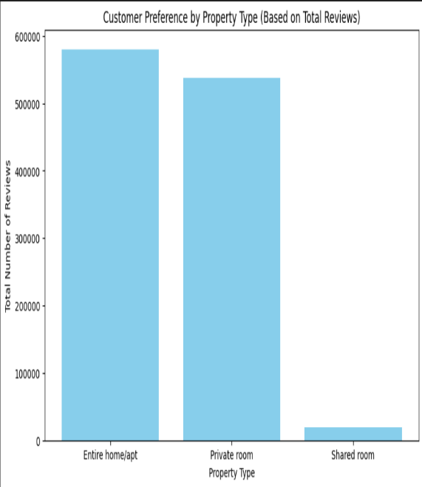
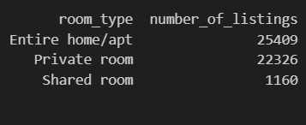
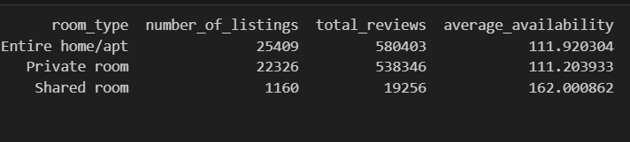
Exploratory Data Analysis
Q3. What are the types of properties that are most successful and least successful for FLH?
Summary:
By analyzing the room_type, FLH can determine which property types (e.g., Entire home/apt, Private room)
are driving the most customer engagement and bookings.
This insight allows the company to focus on promoting successful property types while improving
or rethinking the strategy for less successful ones.

Slide 12
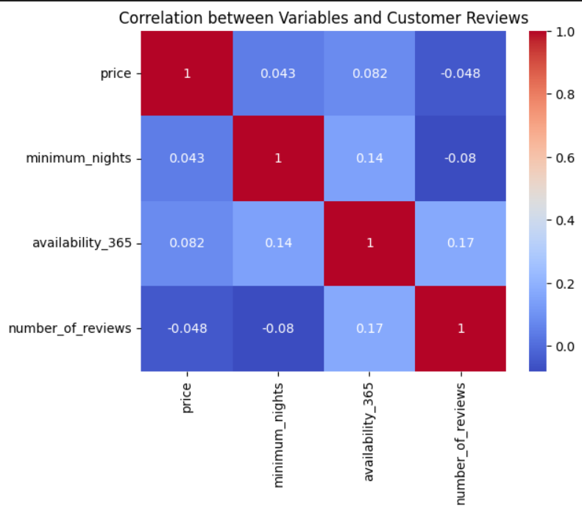
Exploratory Data Analysis
Q4. What are customers looking for most in their stays with FLH?
Interpretation:
Room Type: If certain room types (e.g., Entire home/apt) have significantly more reviews, it suggests a strong customer preference for those types.
Price Sensitivity: By correlating price with reviews, you can understand if higher or lower prices attract more reviews, indicating price sensitivity.
Neighborhood Preferences: If certain neighborhoods consistently have higher reviews, it may suggest customers prefer those locations

Slide 13
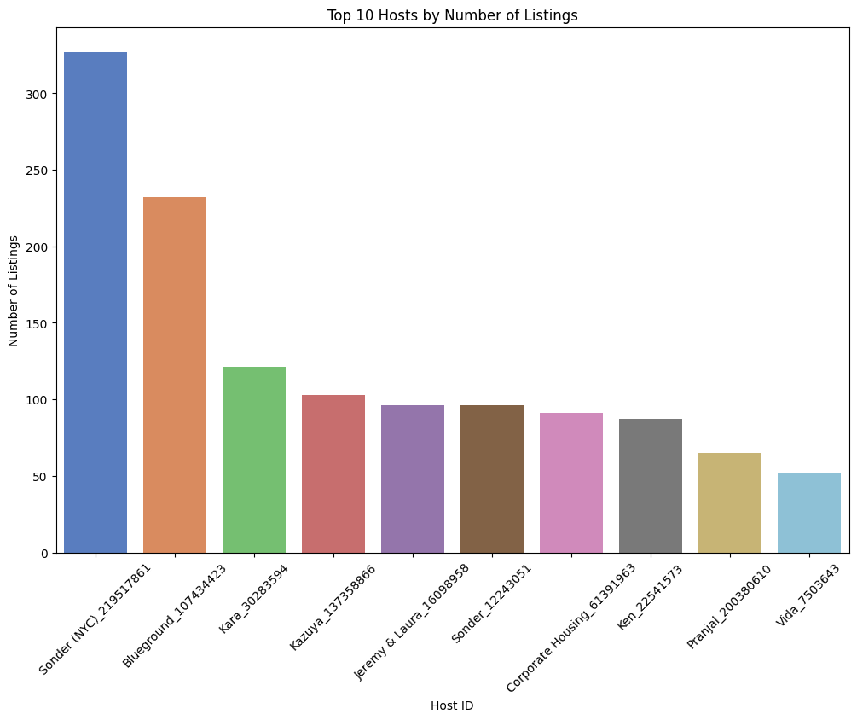
Exploratory Data Analysis
Q5. What attributes do the hosts have that FLH should target to add to their service to increase revenue?
Attributes of Hosts to Target for Increasing Revenue
Hosts with High Listing Counts: Hosts like Sonder (NYC) (327 listings) and Blueground (232 listings) manage a large number of properties, indicating experience and capability in handling multiple listings

Slide 14
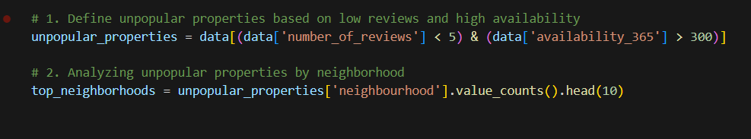
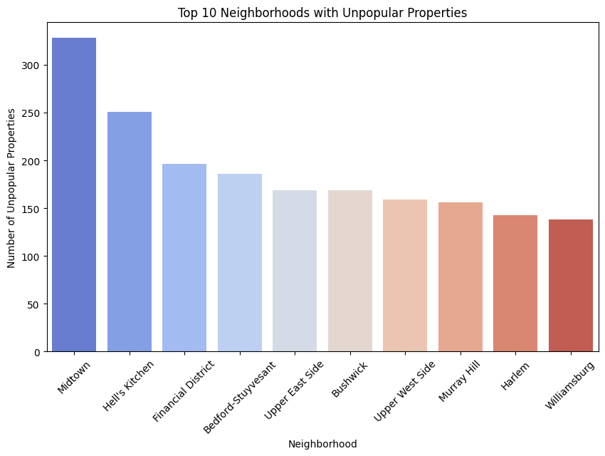
Exploratory Data Analysis
Q6. How to get Unpopular properties more traction?

Slide 15
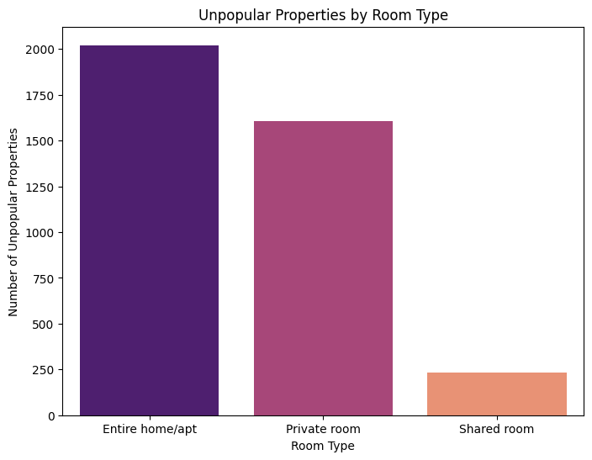
Exploratory Data Analysis
Analyze the Characteristics of Unpopular Properties
Location: Assess if certain neighborhoods are more prone to having unpopular properties.
Pricing: Compare the pricing of unpopular properties to those that are more successful.
Property Type: Determine if certain types of properties (e.g., apartments, houses) are less popular.
Host Attributes: Look at the hosts of unpopular properties. Are they less experienced or less responsive?

Slide 16
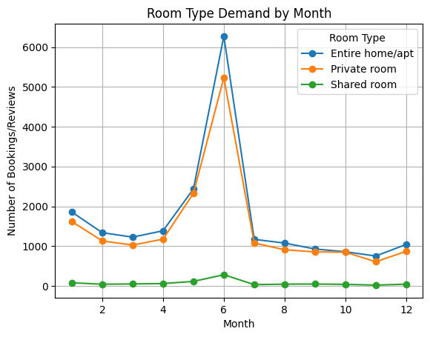
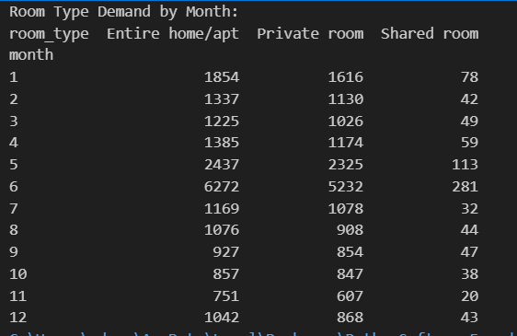
Exploratory Data Analysis

Slide 17
Exploratory Data Analysis
Pointers that might help to improve traction
Based on the analysis, you can implement several strategies to help unpopular properties gain more traction:
A. Optimize Pricing
Dynamic Pricing: Adjust prices based on demand, seasonality, and competition.
Discounts and Promotions: Offer limited-time discounts to attract more customers.
B. Improve Visibility
Highlight in Marketing Campaigns: Feature these properties in email newsletters or social media campaigns.
Promote on the Platform: Use platform-specific tools like "featured listings" to bring attention to these properties.
C. Enhance Property Descriptions and Images
Professional Photography: Invest in high-quality images to make the listings more appealing.
Optimized Descriptions: Rewrite property descriptions to highlight unique features and amenities.
D. Encourage Reviews
Incentivize Reviews: Offer small perks (e.g., early check-in, late check-out) to guests who leave reviews
.Respond to Feedback: Address any negative reviews or common complaints to improve the property.
E. Target Specific Audiences
Niche Marketing: Market the properties to specific groups (e.g., families, business travelers) that might find them more appealing.
Local Attractions: Highlight proximity to local attractions, events, or business centers to attract relevant customers

Slide 18
THANKYOU
Presented By: Uday Devargudi

